Slide 1
Restaurant Recommending Chatbot
Weekly Report - Group 3
Murali Krishna(C0794253)
Swathi Gurijala(C0790294)
Varadharajan Kalyanaraman(C0793756)
Vignesh Kumar Murugananthan(C0793760)

Slide 2
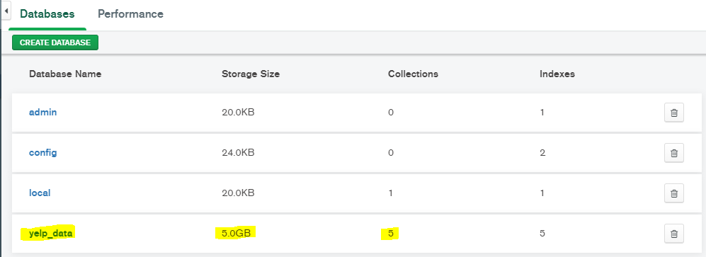
Data Set - Yelp
MongoDB Compass

Slide 3
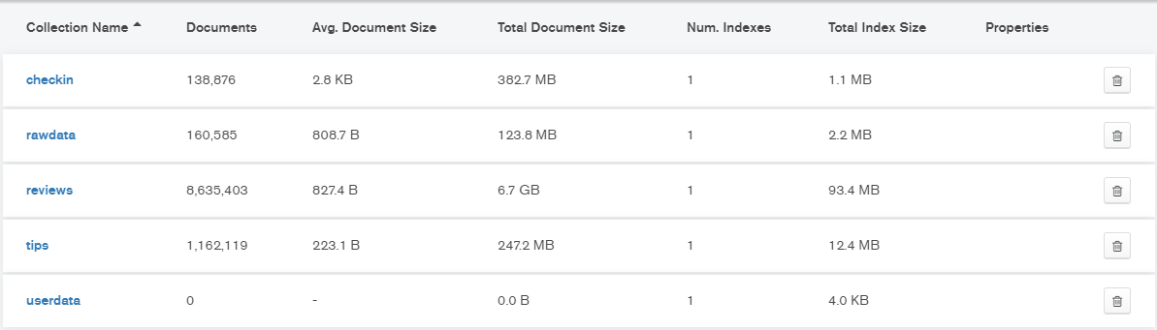
Json Files imported

Slide 4
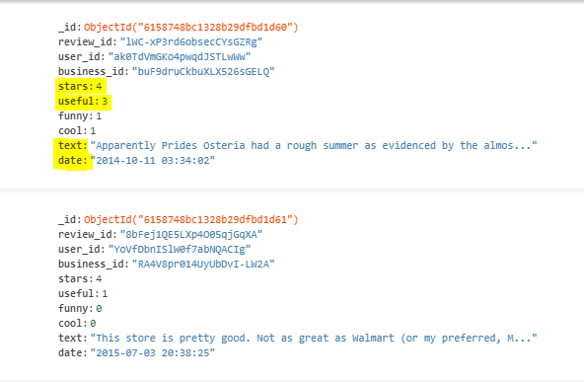
Review data sample

Slide 5
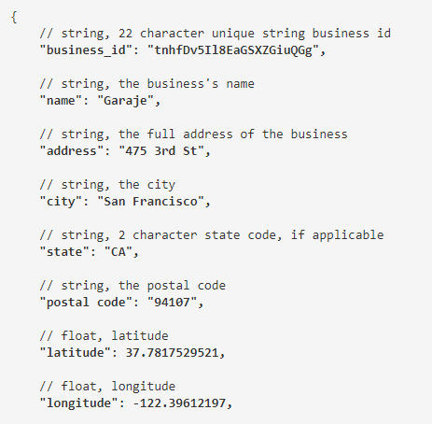

Slide 6
Next week work
Perform initial cleaning of data.
Data Preprocessing.
Apply NLTK processes and structure the data.

Slide 7
Thank You

